Slide 1

Good morning everyone
You are all welcome

Slide 2
What is “promise” in javacript ?
Presented by: Yakubu Andrew iroborghena

Slide 3
What is a Promise in JavaScript
In real life, a promise is an assurance given by somebody to somebody that something will happen. In programming, Promise means that a program calls a function in the anticipation that it will do some useful thing and return the result which calling program can use. The result or promise is the outcome of calling the function which can be a success or a failure, and the data associated with it. So, a promise is a contract between a caller function and the callee function to do something in the future and return the results to the caller function.

Slide 4
Benefits of Promises
Improves Code Readability
Better handling of asynchronous operations
Better flow of control definition in asynchronous logic
Better Error Handling
A Promise has four states
fulfilled: Action related to the promise succeeded
rejected: Action related to the promise failed
pending: Promise is still pending i.e. not fulfilled or rejected yet
settled: Promise has fulfilled or rejected
A promise can be created using Promise constructor. var promise = new Promise(function(resolve, reject){
//do something });

Slide 5
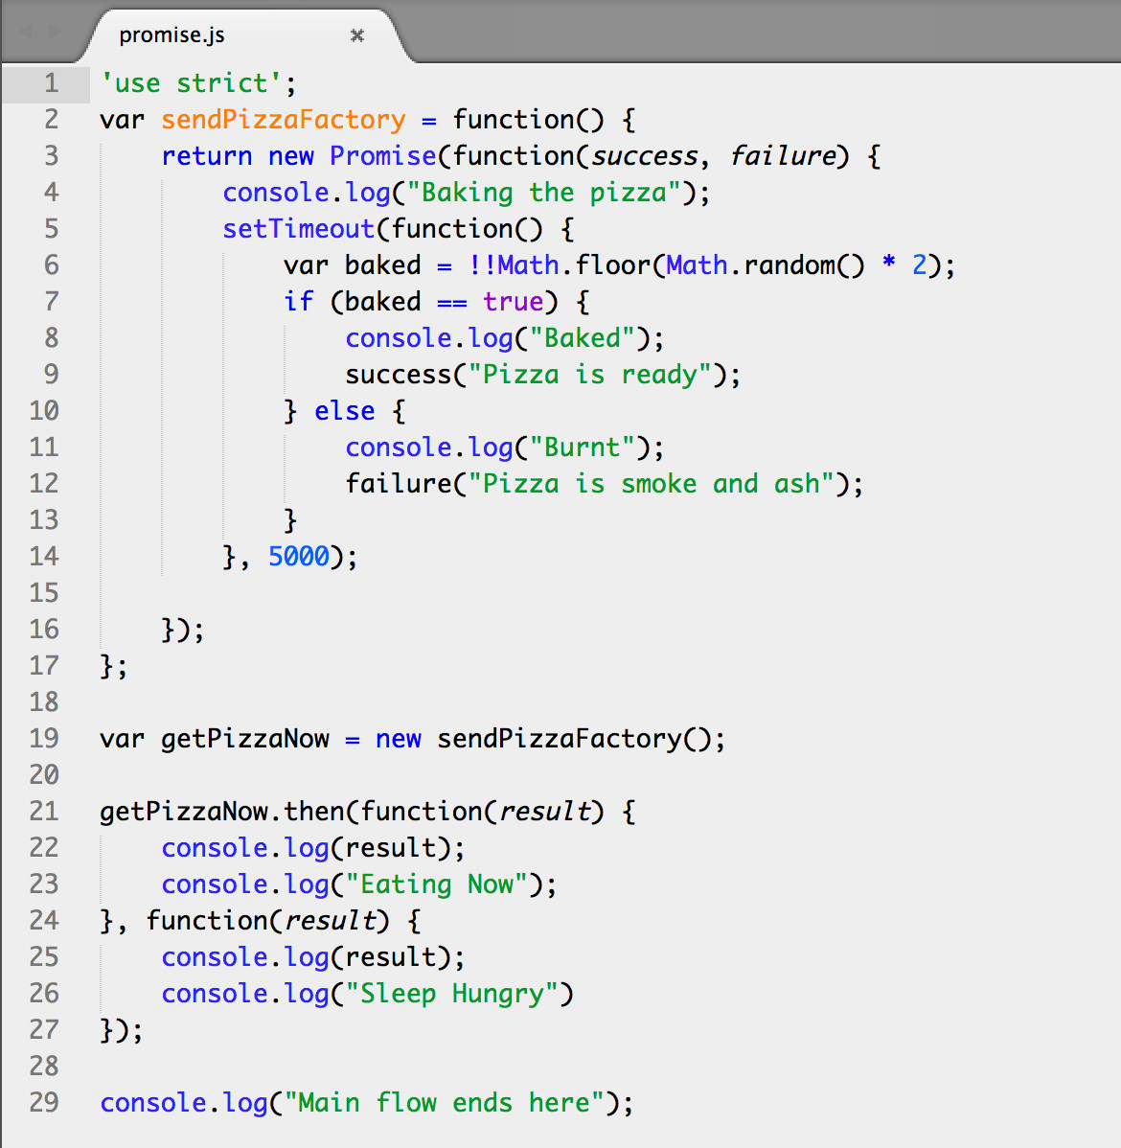

Slide 6
Thanks you all
God bless you plenty plenty

